Slide 1

MATLAB Matrices: Manipulate Matrices
Professor Bo Liu
James Watt School of Engineering

Slide 2
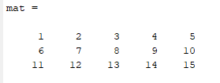


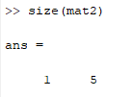
MATLAB size function
The MATLAB size function provides the number of dimensions and the size of each dimension of the input matrix.
See live script

Slide 3
Matrix operators
Operator | Description
+ | Adds the corresponding elements in two matrices, only works on matrices of the same size
- | Subtracts the corresponding elements in two matrices, only works on matrices of the same size
* | Multiplies one matrix by another using standard matrix multiplication
/ | Divides one matrix by another using standard matrix inverse
^ | Raise the proceeding matrix to the power (multiple matrix multiplication)
’ | Generates the transpose of the preceding matrix
[A, B] | Generates a new matrix (matrices A and B joint horizontally)
[A; B] | Generates a new matrix (matrices A and B joint vertically)
See live script

Slide 4
Matrix element operators
Element by element operations operate on the elements of a matrix instead of the matrix as a whole.
Function | Description
.* | Multiply the elements of one matrix by those of another in an element wise fashion, only works on matrices of the same size
./ | Divide the elements of one matrix by those of another in an element wise fashion, only works on matrices of the same size
.^ | Raise the elements of the proceeding matrix to the power of the operand
See live script

Slide 5

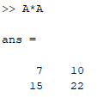

Matrix element operators
Element by element operations operate on the elements of a matrix instead of the matrix as a whole.
Example:
Standard matrix multiplication | Element by element matrix multiplication
See live script

Slide 6



Element by element operations
Standard matrix multiplication:
Element by element multiplication:
Element by element power:
See live script

Slide 7
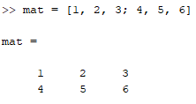

Reshaping matrices
Reshaping means to reorder dimensions.
MATLAB provides the function “reshape(mat, sz)”
  mat is the matrix to be reshaped
  sz is an array of the desired dimensions.
Reshaping in MATLAB maintains column wise order.
reshape(mat, [1, 6])
See live script

Slide 8




Thanks!
#UofGWorldChangers
@UofGlasgow

